Slide 1
Board Improvement Plan 2011-2012
Learning Story

Slide 2
SMART Goal 1 Through a focus on building teacher capacity in literacy instruction…

Slide 3
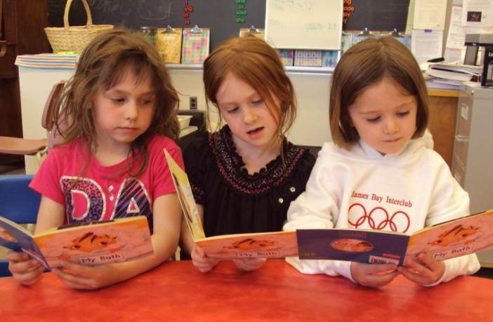
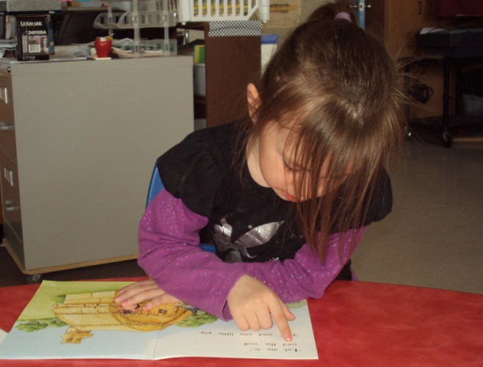
Helping Students Read
All elementary schools have implemented the Leveled Literacy Intervention Program for at risk students

Slide 4
Stepping Up
Intermediate Schools have implemented the Stepping Up With Literacy Tool in their School
St. Pat’s Cobalt
Sacred Heart – Kirkland
St. Anne School
O’Gorman Intermediate

Slide 5
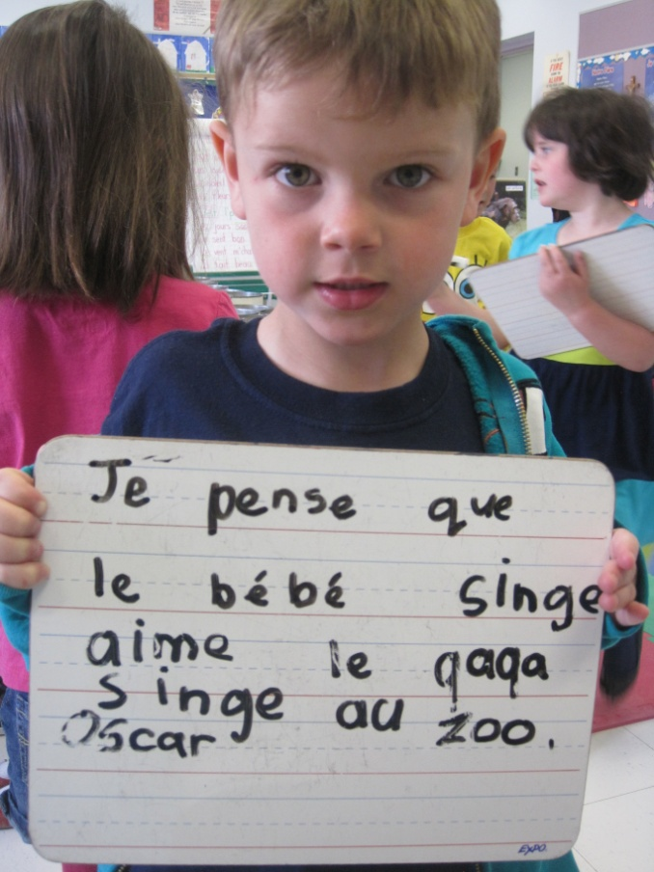
C’est Fantastique!
In our Early Primary Collaborative Inquiry Initiative, Sacred Heart and St. Jerome School worked together to improve the students’ ability to communicate their thinking in French.

Slide 6
SMART Goal 2 Through a focus on promoting problem solving skills and the communication of math ideas…

Slide 7
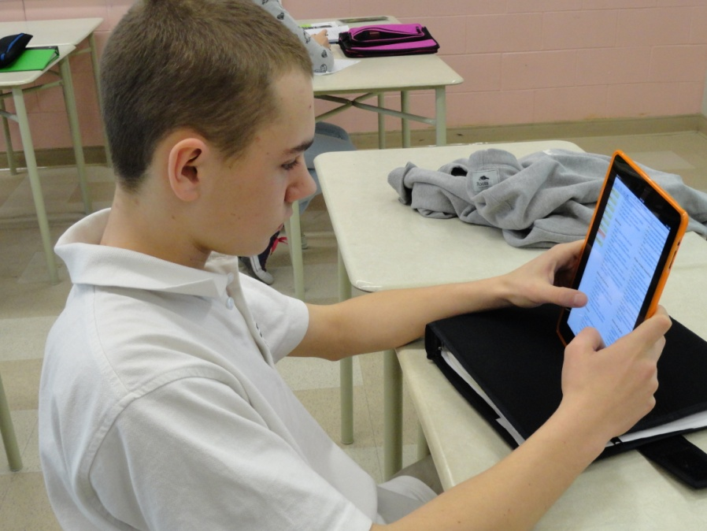
Breaking New Ground
In a New Ministry Pilot Program, teachers in Grade 6 to 12 participated in a MYCI (Middle Years Collaborative Inquiry) Initiative, educators worked together to investigate the importance of questioning.

Slide 8
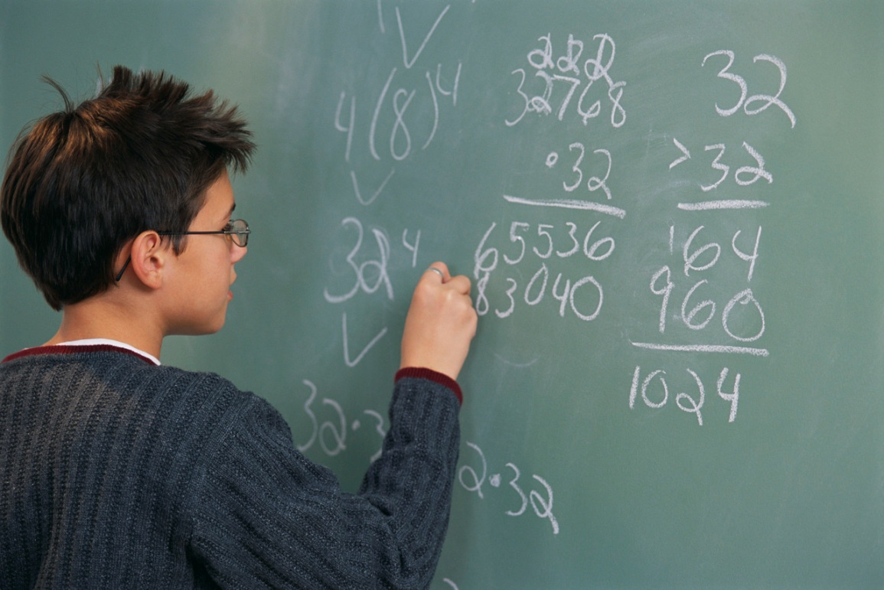
More Collaboration
Junior and Intermediate teachers worked collaboratively to plan and deliver Mathematics lessons to our students. This work has changed teacher practice.

Slide 9
SMART Goal 3 Through a focus on actively preparing students for the 21st Century…

Slide 10
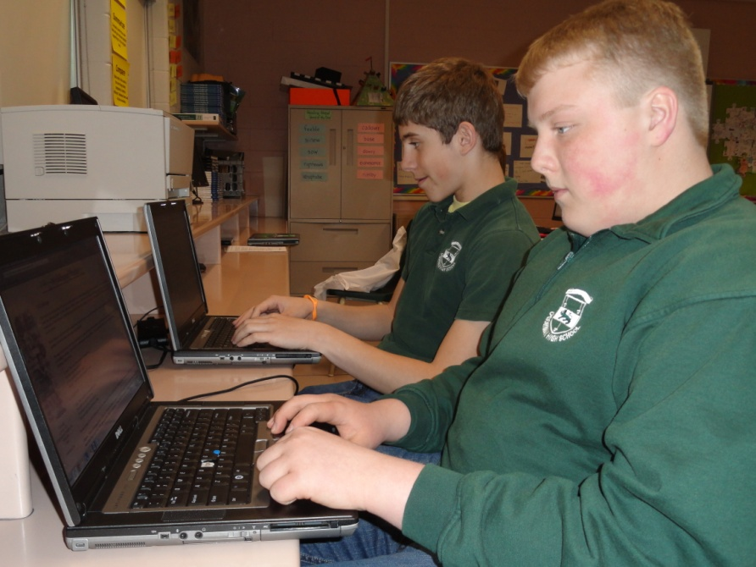
Laptop Program
Technology is a tool to gain new knowledge and deepen understandings to facilitate collaborative learning opportunities. All students in Grade 9 receive a laptop to facilitate their learning.

Slide 11
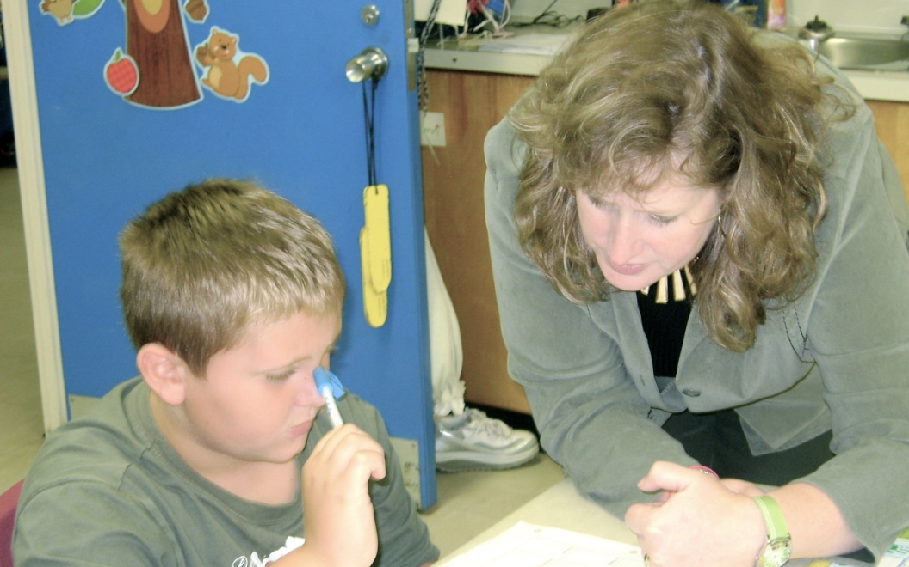
Schools In the Middle Initiative
Students were provided with opportunities to make their thinking visible using the model “What do you think?” and “How do you know?”.

Slide 12
SMART Goal 4 Through a commitment on building collaborative relationships between home and school…

Slide 13
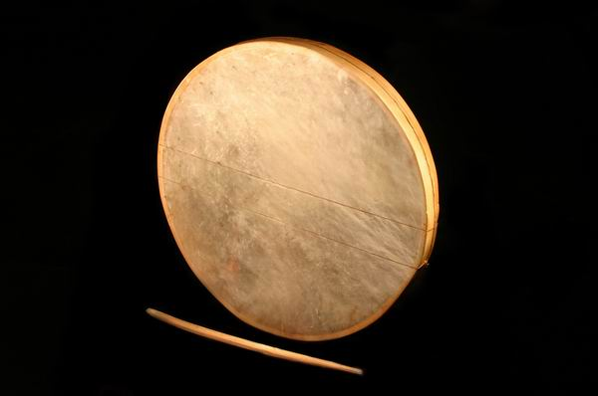
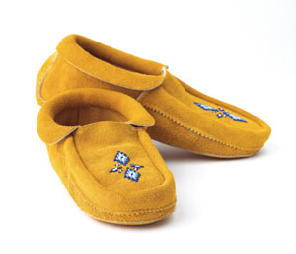
Bringing the Arts Into our Schools
St. Paul School provided students with the opportunity to sign up for Art Workshops. Some of the sessions included: moccasin making, drumming, quilting and beadwork.

Slide 14
Build A Reader
Parents and students at St. Joseph School are reading to another with the Build a Reader Program. Every month, the students receive a book at their reading level.

Slide 15
SMART Goal 5 Through a commitment to building a distinctive Catholic culture in our schools…

Slide 16
Restorative Practice
Many of our schools received further training on restorative justice which is making our schools more inclusive.

Slide 17
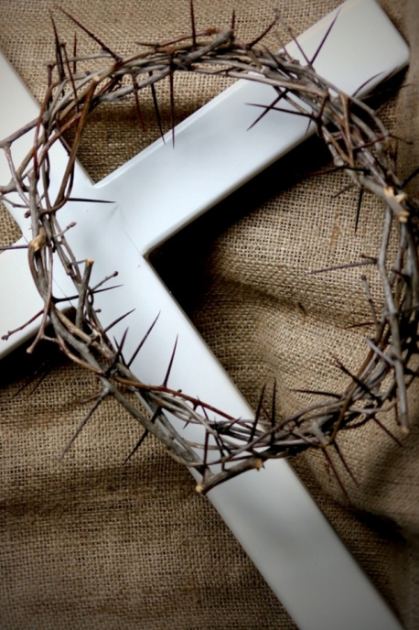
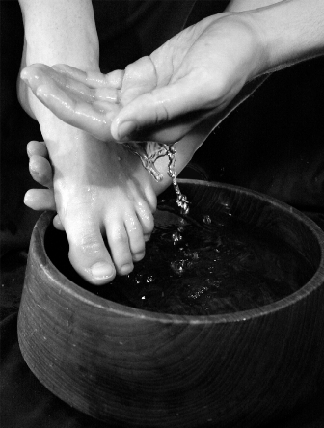
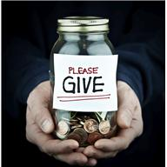
In the News….
The faith development of teachers and students was supported in our virtues and faith newsletters. They were designed to educate and inspire.

